Slide 1
A Low Power SRAM Design
Caroline Andrews
Robert Hunter
Yousef Shakhsheer
December 6th, 2007

Slide 2
Purpose
Develop a functioning SRAM memory device
Implement design features to reduce overall power
consumption
Design a robust memory device that operates over a
large range of temperatures, voltages, and process corners

Slide 3
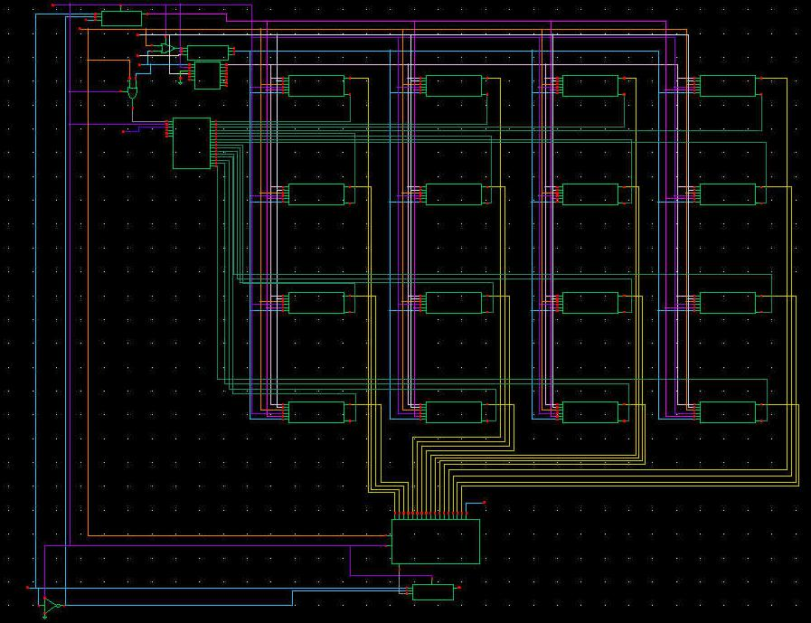
Our design
1MB memory array divided into 16 blocks
Block contains 256 x 256 bit cell array
Memory Block
16-input multiplexer used to select correct block
Block Select
Output Select

Slide 4
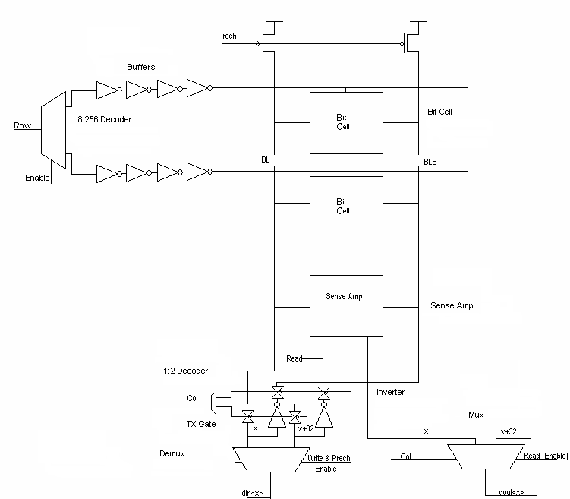
Design cont.
Layout for one block
Memory cells accessed
by column and row decoders
Decoders built with hierarchical design to
reduce power

Slide 5
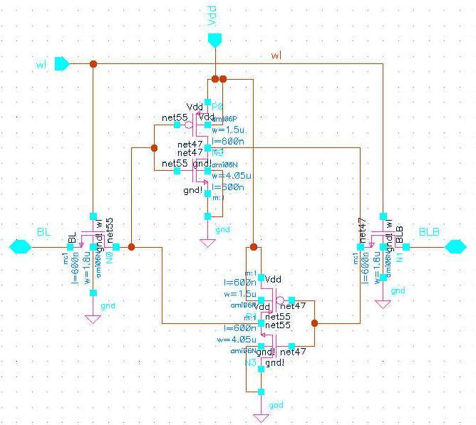
Bitcell Design
NMOS devices
sized larger than PMOS
PMOS W=1.5um
NMOS W=4.05um
WL NMOS W=1.8um

Slide 6
Special Features
Enable signals are distributed throughout the memory periphery
Allow for a considerable reduction in power
Only one memory block is active at any time
Sense amplifiers enabled only during read
When read or write are not asserted, entire periphery is disabled

Slide 7
Features cont.
Power consumption of active components versus inactive components
 | On Power | Off Power | Qty On | Qty Off
Sense Amp | 0.174 mW | 9.4nW | 256 | 3840
256 Decoder | 13 mW | 206 nW | 1 | 15
16 Decoder | 5.906 mW | 11.54 nW | 0.8 | 0.2
8 Decoder | 4.062 mW | 5.78 nW | 2 | 15
Tx Gates | 10.2 μW | 1pW | 64 | 4288
16-Mux | 220 μW | 15.6 μW | 32 | 480
8-Mux | 199 μW | 10 μW | 32 | 480
Inactive power is much less than
active power for all of the
peripheral devices
Result: Inactive devices are consuming much lower values
of power, preventing wasteful consumption when not in use

Slide 8
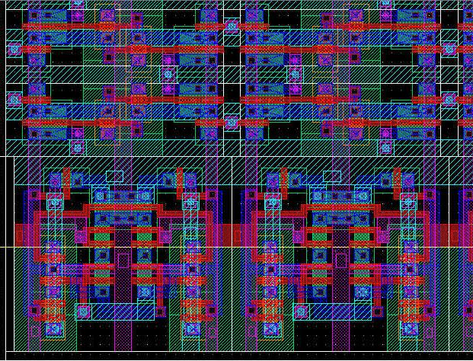
Layout Design
Four 6T bit cells
Memory cell
  Flat Layout
  Bit cells are tiled and overlap on all sides
  Area: 239.04 μm²
  Effective: 182.03 μm²
  Sense amps snap directly onto bit cell array without routing
Two Sense Amps

Slide 9
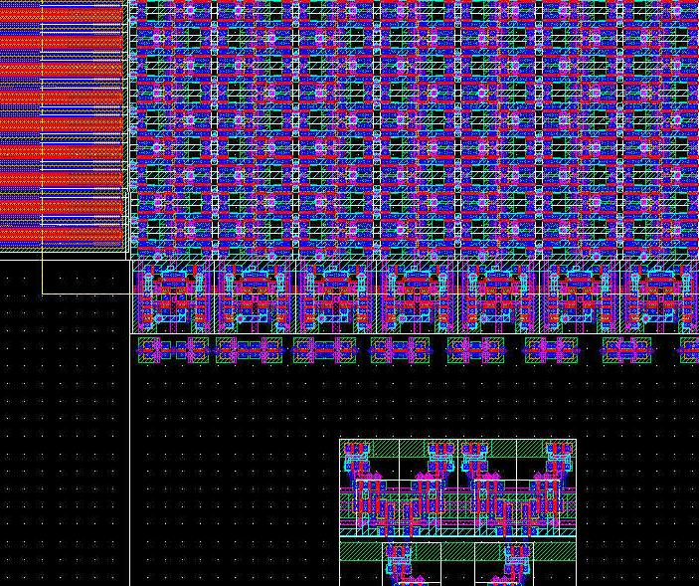
Layout cont.
Word line drivers
Transmission Gates
8 to 1 Multiplexer

Slide 10
Results
Metric | 10388006 W² * ns * μm²
Bit Cell Area | 239.04 μm² (Effective: 182.03 μm²)
Total Area | 256099200 μm²
Read Power | 29.4 mW
Write Power | 30.56 mW
Total Power | 132.8 mW
Read Delay | 2.3 ns
Write Delay | 1.4 ns
Total Delay | 2.3 ns

Slide 11
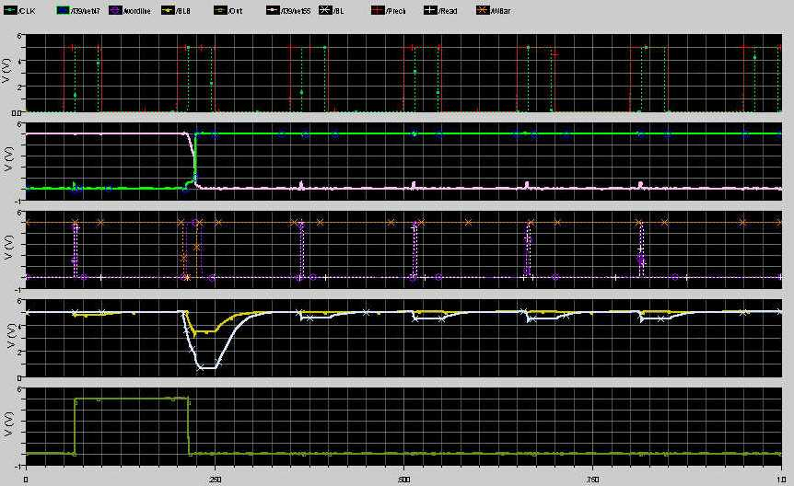
Simulations
Read and write operations
Sense amp executed
after 0.5 V drop in BL
Output latched in
register on rising edge
of clock

Slide 12
Simulations cont.
Memory Block simulated at all voltages, temperatures, and
process corners
    V(4.5, 5, 5.5) T(0C, 27C, 50C) P(TT, FF, SS, SF, FS)
    Done for 1bit Read and Write
Memory Block also simulated under 32-bit Read and Write

Slide 13
Summary
Memory blocked successfully designed and simulated under
variety of conditions
Power consumption is minimized with enable signals on
memory periphery
Area is minimized with overlapping bitcells and sense
amplifiers
Further development could result in more power savings

Slide 14
Questions?

